Slide 1




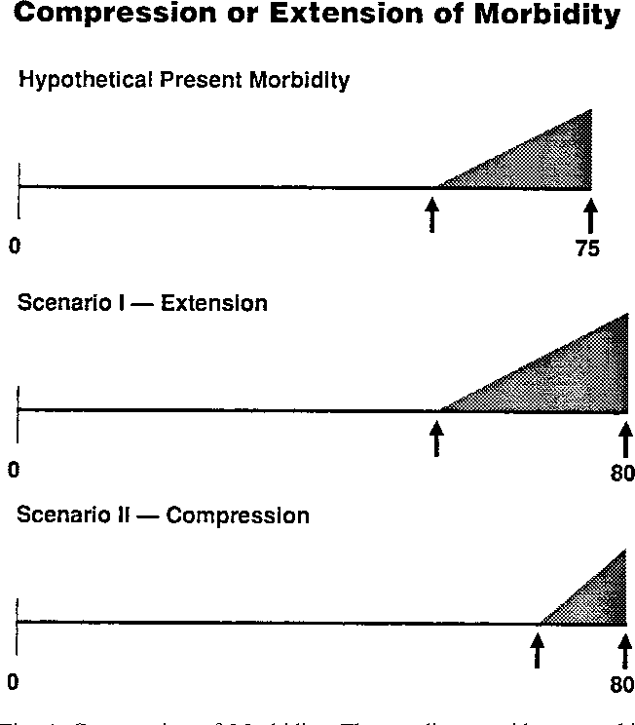
FAA/CAMI Aviator State Prediction Problem
Large, commercial healthcare datasets
{Diagnoses, medications, time}
Quantitative Risk Estimate
Risk estimate < Allowable Level of Safety (ALoS)
Yes
Grant medical certification
Aviator
Aviator Medical Risk Gunculator
No
Deny medical certification
Desired attributes
Predictive accuracy
Understandability/transparency
Legally defensible
Risk of what?
A change in chronic health state (compression of morbidity theory) in the next period of interest (e.g., 1 year)
What does this look like in a healthcare claims dataset?
New diagnoses for chronic conditions
New diagnoses that persist over time
Addition of medications
Increasing frequency of healthcare interactions
Incremental vs. linear changes in morbidity state
Anthony Tvaryanas, 10/27/21

